Slide 1
Use-Case-Based UI Design
Klipper-DGUS_CR6
Thinkersbluff

Slide 2
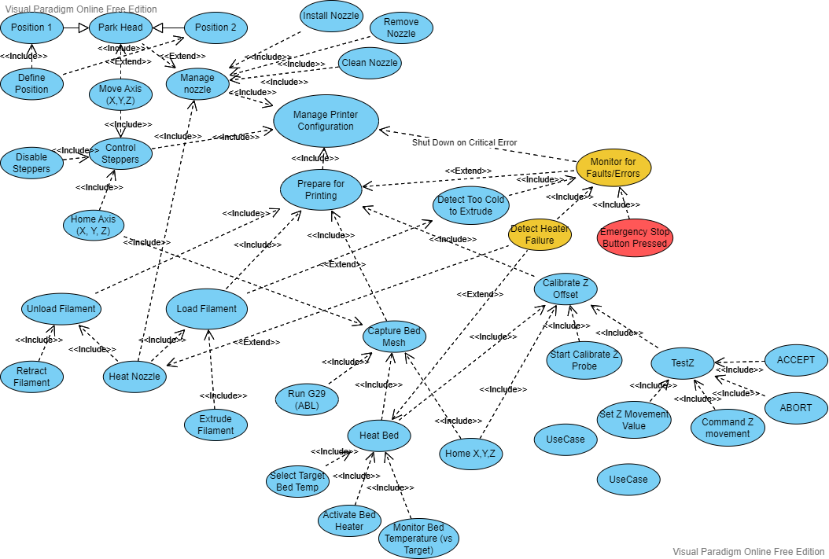
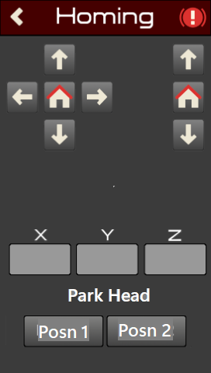
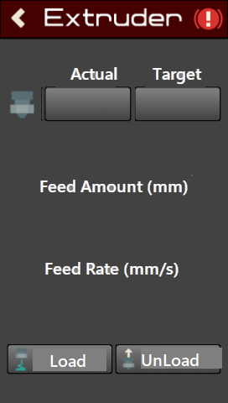
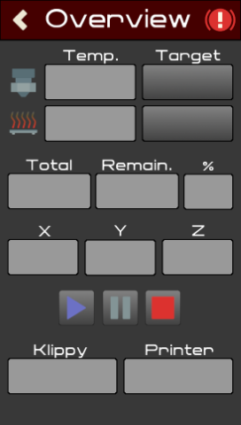
M
M
665
665
4
5
M
10
231
1
C
4
F
F
5
8
7
F
665
F
10
1
231
K?
9
221
7
8
6
231
221
Capability Analysis – v0.7
10
K?
Klipper firmware function?
Monitor Nozzle Temp (vs Target)
1
Not supported
M
Manual Operation
C
Configuration File
9
F
Klipper-dgus firmware function

Slide 3
Proposed Klipper-dgus changes, based on Capability Analysis
Capability | Issue(s) | Option(s)
Disable Motors | No control provided | Add button to Homing Page – Send Klipper GCODE M84 XYZE Optionally, allow a selective disabling
Pre-Define Temperature settings (PLA, PETG, etc.) | No control provided | Add a “Configure PreSets” menu Add Control(s) to set target values based on preset values stored in DWIN memory
Define Posn1, Posn2 | Currently only available by editing macro config file | Add ability to override the X, Y, Z values on a new Configure PreSets menu
Calibrate Z Offset | No controls provided for using the Klipper Probe Calibrate functionality. | Add a new Calibrate menu or include in proposed Configure PreSets menu Add buttons to issue the Klipper commands Activate Probe Calibrate and TestZ, Accept, Abort, & TestZ Amount.

Slide 4
Proposed Klipper-dgus changes, based on Capability Analysis
Capability | Issue(s) | Option(s)
MACROS | No option for running user-defined macro functions | Enumerate available macros and enable user to run them from a new Macros screen Maybe able to exploit a Klipper object? Would allow user to extend some capabilities without Python or DGUSTool skills, like RUN ABL
Console | No support for Console display or input | May be able to display a “Read-Only” console from a Klipper object? Imagine rather complex to support inputs?

